Slide 1
Introduction to Pandas

Slide 2
Pandas
pandas is a Python package providing fast, flexible, and expressive data structures designed to make working with “relational” or “labeled” data both easy and intuitive. It aims to be the fundamental high-level building block for doing practical, real world data analysis in Python. Additionally, it has the broader goal of becoming the most powerful and flexible open source data analysis / manipulation tool available in any language. It is already well on its way toward this goal.

Slide 3
Why will this make my life easier?
Easy handling of missing data (represented as NaN) in floating point as well as non-floating point data
Size mutability: columns can be inserted and deleted from DataFrame and higher dimensional objects
Automatic and explicit data alignment: objects can be explicitly aligned to a set of labels, or the user can simply ignore the labels and let Series, DataFrame, etc. automatically align the data for you in computations
Powerful, flexible group by functionality to perform split-apply-combine operations on data sets, for both aggregating and transforming data
Make it easy to convert ragged, differently-indexed data in other Python and NumPy data structures into DataFrame objects
Intelligent label-based slicing, fancy indexing, and subsetting of large data sets
Intuitive merging and joining data sets
Flexible reshaping and pivoting of data sets
Hierarchical labeling of axes (possible to have multiple labels per tick)
Robust IO tools for loading data from flat files (CSV and delimited), Excel files, databases, and saving / loading data from the ultrafast HDF5 format
Time series-specific functionality: date range generation and frequency conversion, moving window statistics, moving window linear regressions, date shifting and lagging, etc.

Slide 4
Series and DataFrames
Series: 1-D array – data with an index (or not)
DataFrame: multi-D array with an index (or not). Made up of multiple Series.

Slide 5
Data I/O
Import pandas
Import pandas as pd
Read data or create data
df = pd.read_excel(‘file’)
See documentation for many ways to modify this
Pandas will guess at unknowns (it does a decent job)
Set it and forget it. It’s worth it.
df = pd.DataFrame([1,2,3,4],index=[‘a’,’b’,’c’,’d’])
Do something to it
Anything at all
Write data
df.to_xxx(‘outfile’)

Slide 6
Common read parameters
df = pd.read_table([file name], param1=x, param2=x) read_csv read_json read_excel
sheet_name = name or number of Excel sheet
header = row number of header row
skiprows = number of rows to skip at the top
index_col = number of column to use as a row index
names = list of manually defined column names
usecols = list of column numbers to use (don’t waste time reading data you don’t need)
parse_dates = True|False Pandas tries to parse dates into datetime objects. Very useful and well done, but slow. Can also hard code date converter.
See documentation for more….
Specialied functions for: csv, json, html, clipboard, excel, hdf, feather, parquet, msgpack, stata, sas, pickle, sql, gbq. read_table is most general.

Slide 7
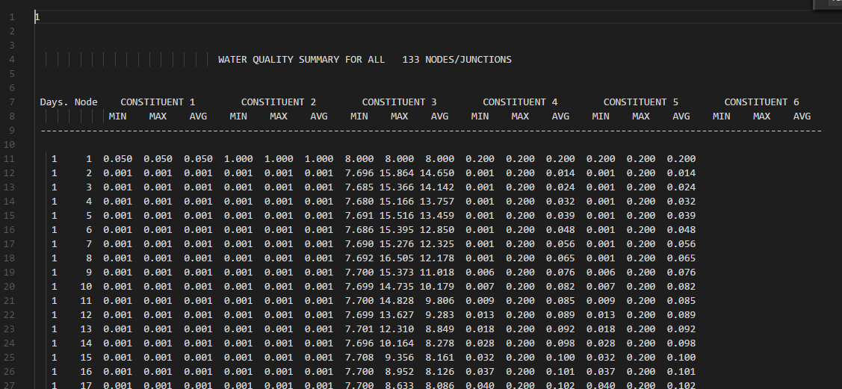
Sample read function
df = pd.read_table(jsmfile, delim_whitespace=True, skiprows=10, usecols=[0,1,15], skip_blank_lines=False, header=None, names=["days", "node", "RawEC"])
jsmfile:

Slide 8
df = pd.read_excel(‘pathtodata.xlsx’)
read_table
read_csv…
df[‘Series1’] = [1 9
2 6
…
7 3000]
DataFrame “df”
df[‘Series1’].max() = 8500
Index | Series1 | Series2 | Series3 | Series4
1 | 9 | Yes | mg/m3 | Bladensburg
2 | 6 | No | mg/m3 | Benning Road
3 | 6 | No | mg/m3 | Ana PA Ave
4 | 8500 | Yes | mpn/100ml | Bladensburg
5 | 1120 | No | mpn/100ml | Benning Road
6 | 4100 | Yes | mpn/100ml | Ana PA Ave
7 | 3000 | No | mpn/100ml | Upstream Rockcreek
df[‘Series1’].sum() = 16741
df2 = df[df[‘Series2’]==“Yes”]=
df[T,F,F,T,F,T,F]=
Index | Series1 | Series2 | Series3 | Series4
1 | 9 | Yes | mg/m3 | Bladensburg
4 | 8500 | Yes | mpn/100ml | Bladensburg
6 | 4100 | Yes | mpn/100ml | Ana PA Ave
df[df[‘Series2’]==“Yes”][‘Series1’].sum()=
[9,8500,4100].sum()= 12609
df2.to_excel(‘pathto_output.xlsx’)
to_json
to_csv…

Slide 9
Useful pandas functions
See Cheat Sheet in folder

Slide 10
Subset Observations
df.head(5) #Display the first 5 rows
df.tail(5) #Display the last 5 rows
df.sample(frac=0.5) #Randomly select half of the rows
df.describe() #Display basic stats
Slice data
iloc for numerical indices, loc for named indices
df.iloc[10:20,2:3] #Display rows 10-20, columns 2-3 (0 index)
df.iloc[:,2:3] #Display all rows, columns 2-3
df.loc[:,’C’] #Display column C Same as df[‘C’]
df[’C’] = df[’A’] #Copy column A as column C
df[’C’] = df[’A’] * 0.4536 #Apply an operation to a column
Can also use apply for a complicated function
df[’C’] = df[’A’].apply(np.log) #Take the log of everything in column C.

Slide 11
Doing stuff to data
df[’C’] = df[’A’] * 0.4536
Apply an operation to a column
Can also use apply for a complicated function
df[’C’] = df[’A’].apply(np.log)
Take the log of everything in column C.
def myfunction(x):
return x+x-x*x/35+22
df[’C’] = df[’A’].apply(myfunction)
Do complicated math

Slide 12
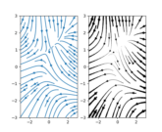
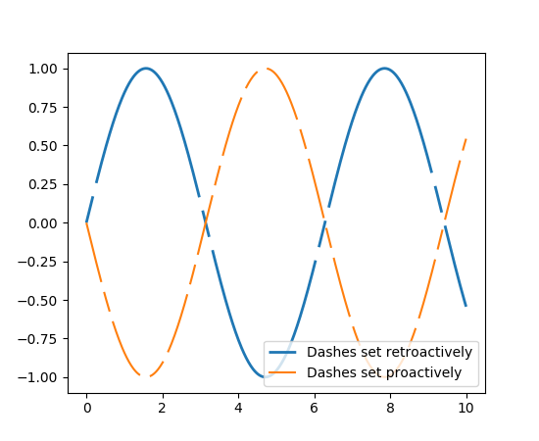
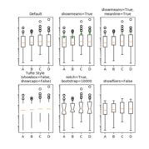
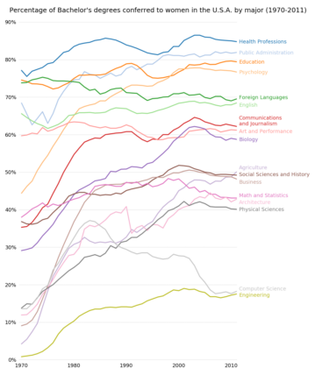
Intro to Matplotlib
If you’ve plotted in MATLAB, this will be familiar
Matplotlib is incorporated in jupyter notebooks
Export to high quality .png or interactive window

Slide 13
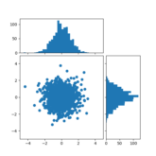
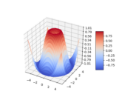
Intro to Matplotlib
Go to https://matplotlib.org/gallery.html for great starting points.
Find a plot that is similar to what you want to do and make modifications

Slide 14
Non-static graphics
Other packages are better for animations, non-static graphics, and web-based graphics
Bokeh
Plotly
Geoplotlib
Seaborn
ggplot (for you R pros – ported ggplot package)

